Slide 1
Image
Company Web Address

Slide 2
Problems
First tackled issue/market need
Second tackled issue/market need
Third tackled issue/market need
Or
Case examples/stakeholder story
And
List current solution and why this is not doing well
Notes:
Points to answer:
What are you aiming to tackle? What are the paint points?
Define the problem you are solving and for who
What are the current solution not answering the current needs?

Slide 3
Solution
Product/
Service visuals
Product/
Service visuals
Feature A
Feature B
Notes:
Questions to answer:
What is your product/service about?
What is your unique value proposition?
What are you offering to the market needs displayed in the previous slide?
A link to a demo will be a plus

Slide 4
Social Impact (Optional)
Theory of Change
Impact evidence
Include picture
Example:
Notes:
Questions to answer:
What is your theory of change? How are you intending to create impact?
How do you define your direct and indirect social and/or environmental impact?
How do you measure your impact? What assessment had been/will be done?
What evidence have you gathered regarding the social efficiency of your solution?

Slide 5
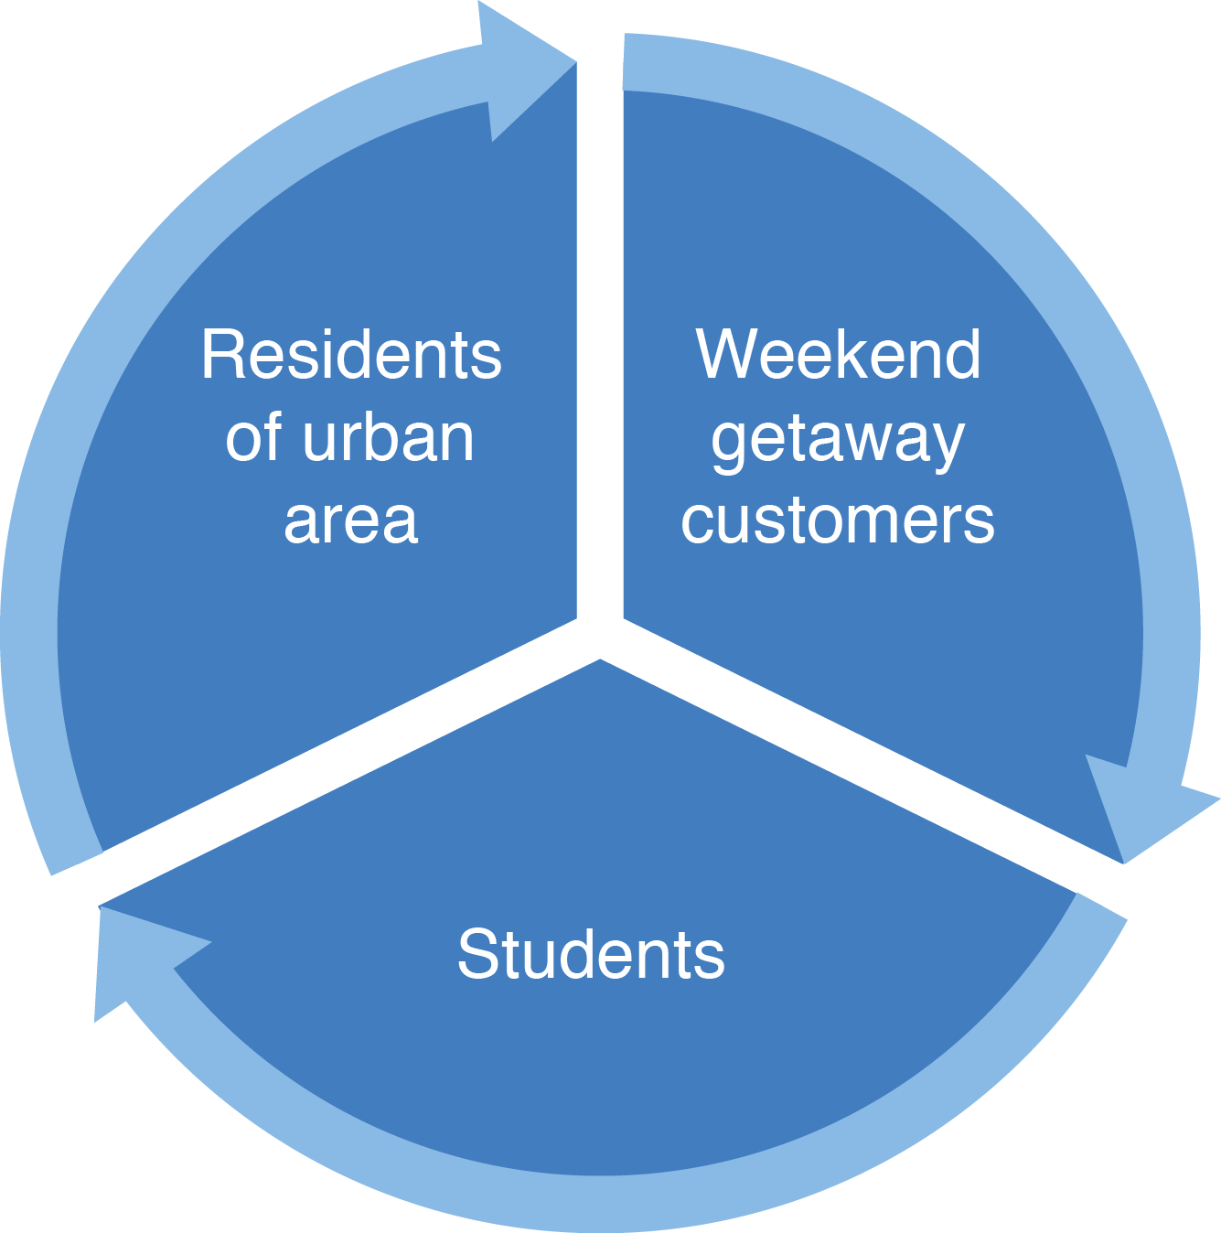
Target Customer
Example:
Chart 1
Chart 2
Notes:
Questions to answer:
Who are your customers? Clearly define who you serve
Who are your stakeholders navigating around your company?
How do you segment your market?

Slide 6
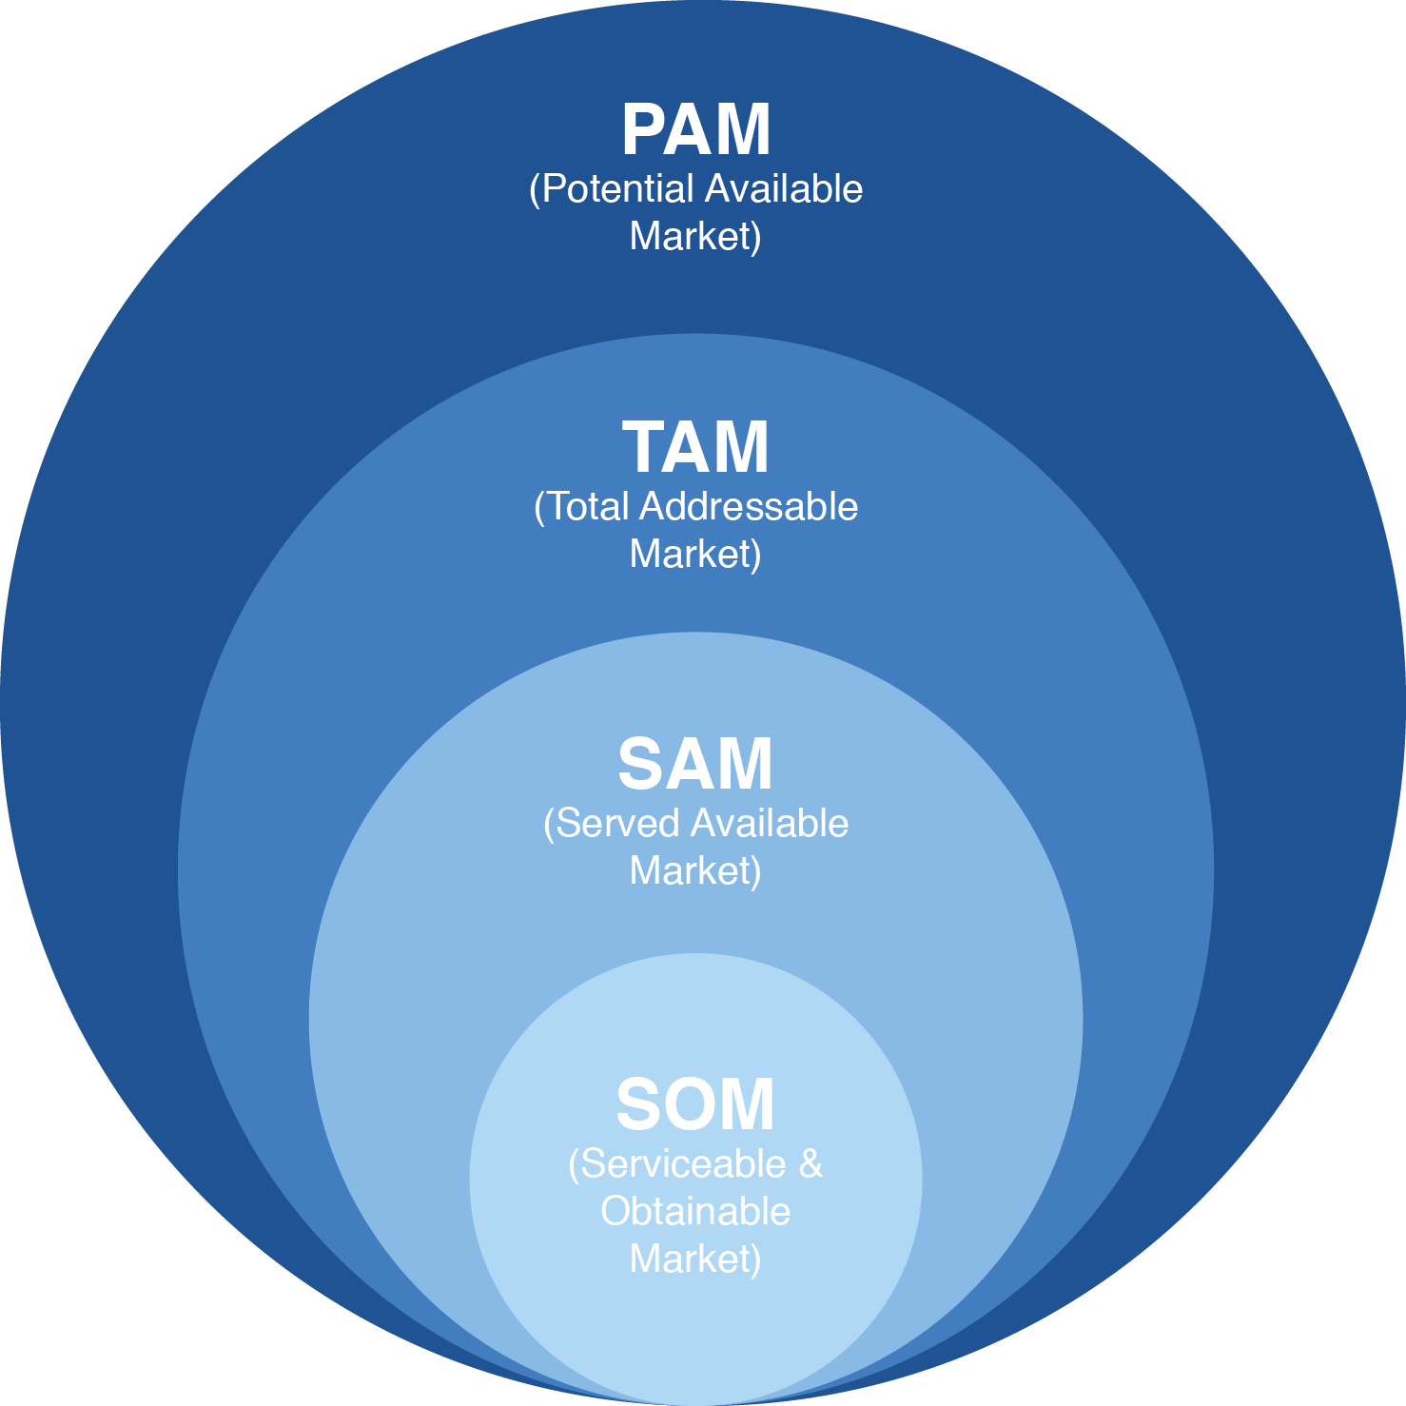
Market Sizing
Example:
Notes:
Questions to answer:
How do you proceed on computing your market sizing?
How big is the market you are operating in?
How much market share are you aiming to?
Data driven slide. Macro trends and insights that affect your market will be a plus

Slide 7
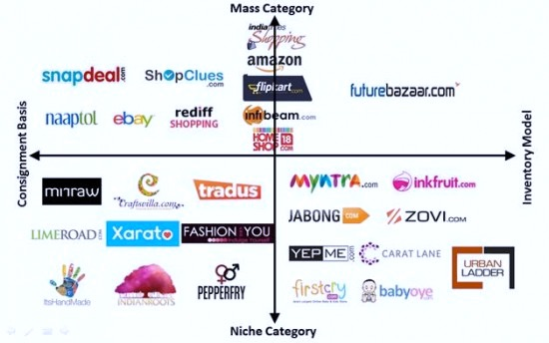
Competitor and Positioning
Example:
Notes:
Questions to answer:
Who are your direct and indirect competitors? How are they performing?
Where are your positioning yourself?
How will you win the market vs. competition?
What is your unique value proposition?

Slide 8
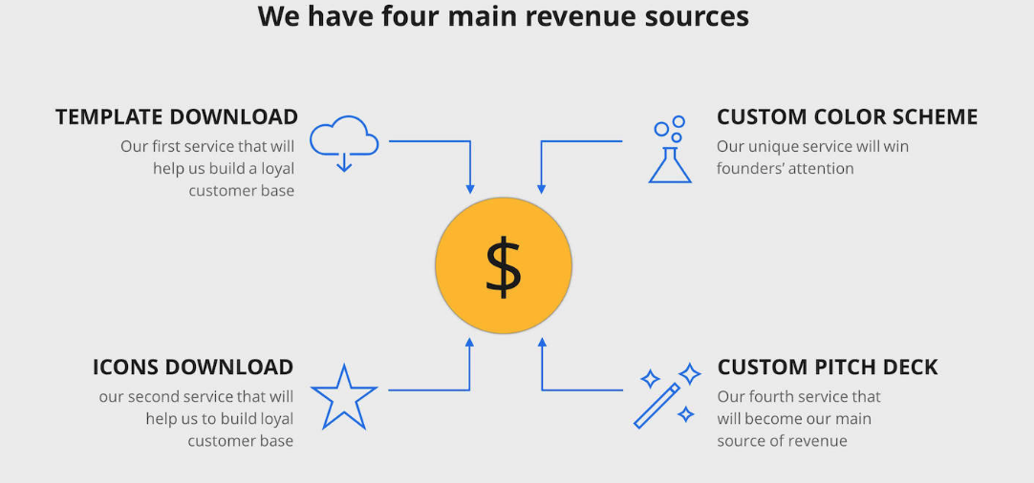
Monetization/Business Model
Monetization A
Monetization B
Monetization C
Example:
Notes:
Questions to answer:
What is the pricing model, How are you going to make money?
Where do you get the money from?
Show basic computation on revenues and conversion rates
Life-time value would be a plus

Slide 9
Team
CEO
Picture
CTO
Picture
COO
Picture
Name
Citizenship
Position
Background/Achievement
Education
Role
Advisor
Picture
Advisor
Picture
Name
Position
Background/Experience
Notes:
Questions to answer:
Who is the dream team behind this business?
Why should we invest in you?
Show your relevance and passion here

Slide 10
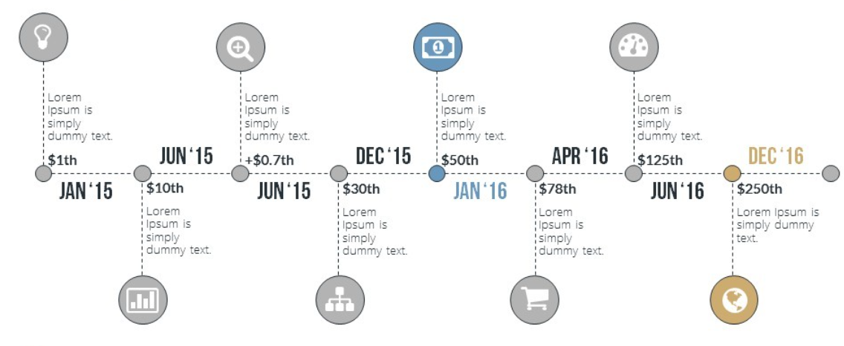
Milestones and Tractions
Example:
Example:
Notes:
Questions to answer:
Show your timeline and milestones to date
What are the achievements? Revenue and number of customers to date (if exist)
Highlight press, partnerships, accolades
Customer success stories and/or testimonials

Slide 11
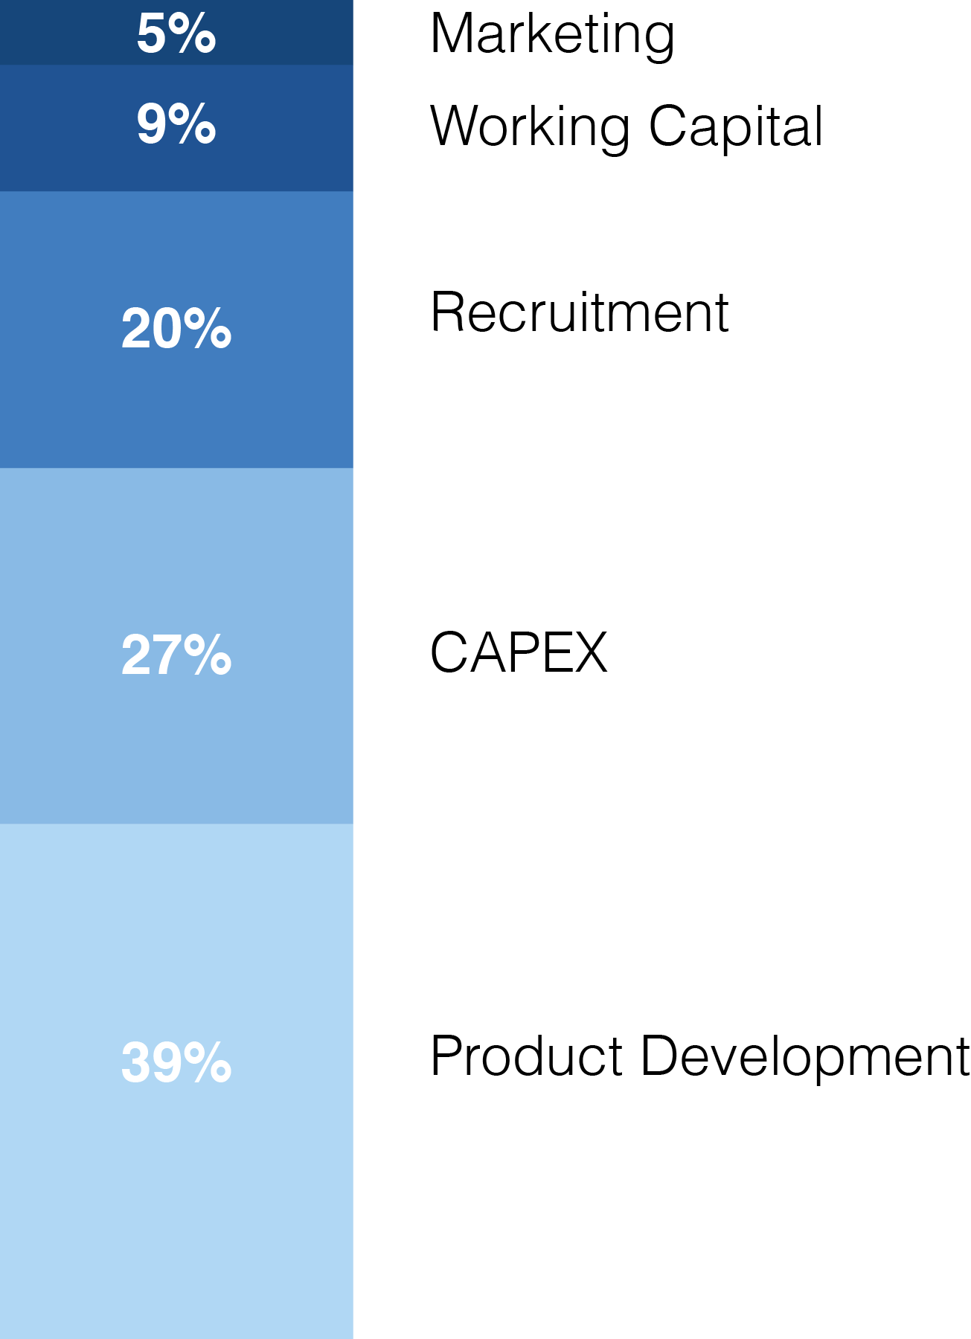
Funding Needs and Allocation
Total Funds Needed (in USD or IDR)
Investment instrument (debt, convertible, straight equity)
Use of funds/allocation per proceed
Runway (how long this funding going to last?
Current and future burn rate
Estimated valuation
Notes:
Questions to answer:
How much funding do you need / how much of your company (% equity) will you give away for that?
How are you going to use the money? How will you allocate the resources?
When is your next funding need forecasted to be?

Slide 12
Strategy
Example:
Notes:
Questions to answer:
What is your vision for the company? Where do you want to take your company?
How do you see your company growing and evolving over time and rounds?
What will be the major milestones over the next two years?

Slide 13
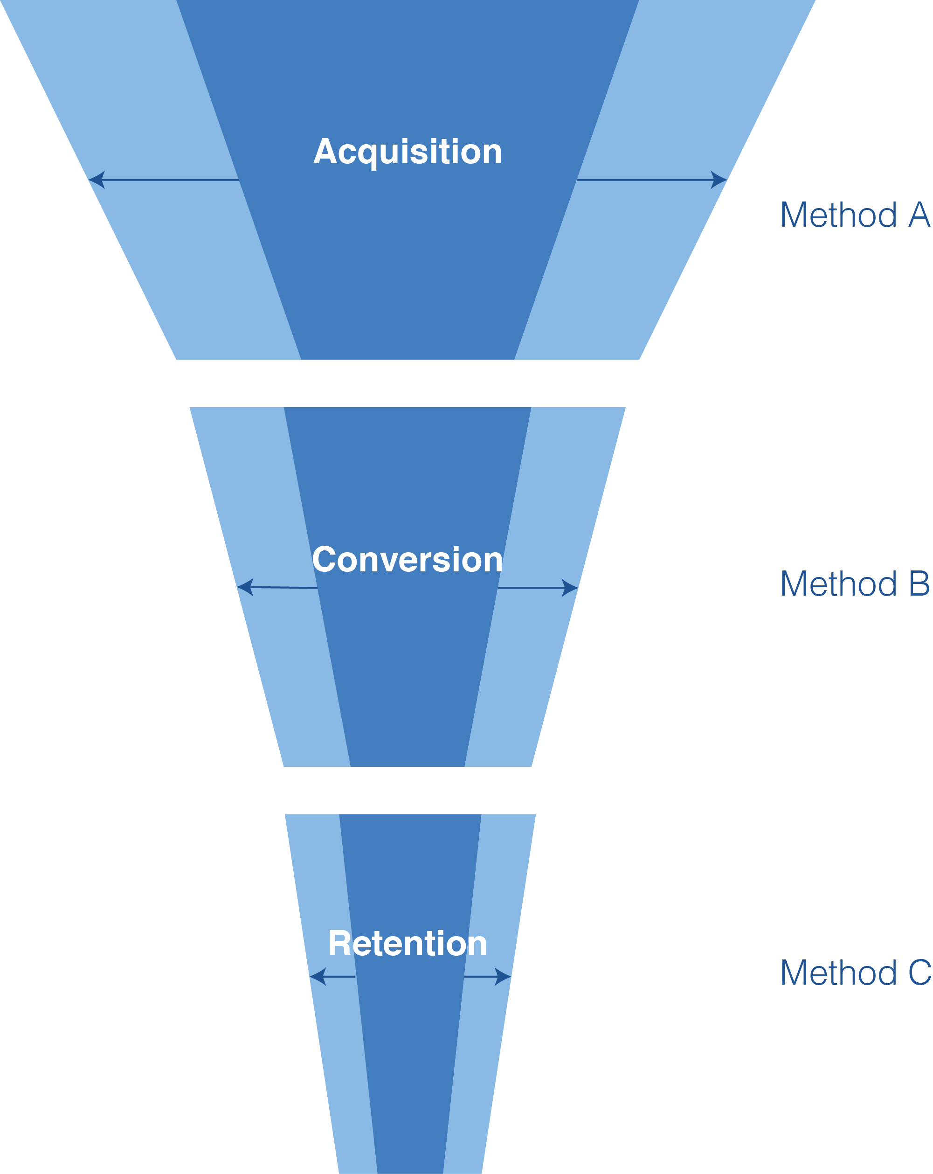
Marketing and Customer Acquisition
Example:
Notes:
Questions to answer:
How are you going to hack your customer growth?
How will you achieve your target growth rates?
What are the most important channels and methods you will use to find and win customers?

Slide 14
Projections
Highlight key metrics:
Impact metrics (KPI)
Total Customers
Total Revenue
Total Expense
EBITDA
Net profit
Example:
2-year detailed Financial Projections (Profit and Loss) + next 3 years (mainly extrapolations)
Notes:
Questions to answer:
How will you grow top line (revenue) and bottom line (profit)
Focus on next 2 years and extrapolate on the following 2 to 3 years

Slide 15
Contact Details
Address
ABC Street, Jakarta 12345
Phone Number
021-12345678/890
Email Address
info@companyname.com
Website
www.companyname.com
Notes:
Provide contact info.

